Slide 1
EART 28202 : Structural Geology
Class 1 : The Geometry of Folds and Congruent Minor Structures
Notes:
In the notes panes to these slides there are numerous references (figure credits and further reading). If the reference is incomplete it refers to the references stated in the reading list on the last slide
With regard to figures in this PowerPoint file, many will be subject to copyright restrictions. I don’t care about you using any of the figures/photos that are mine (Steve Covey-Crump), although a credit would be nice, but take care to comply with copyright restrictions if you reuse any that are not

Slide 2
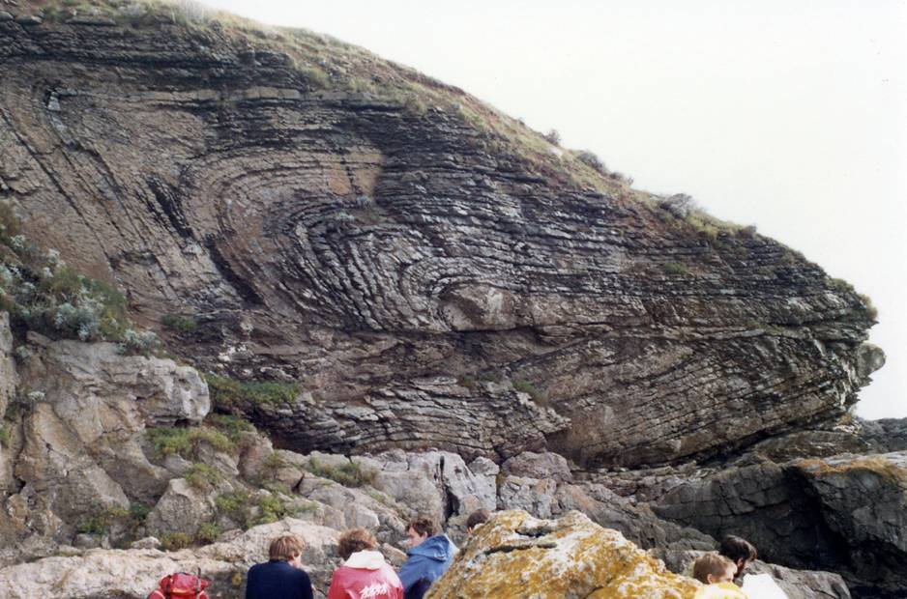
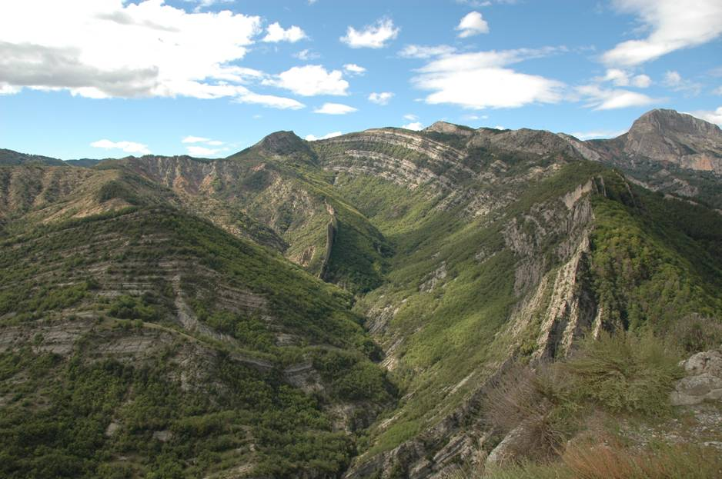
Folding
A geological surface (e.g., bedding, cleavage) that is curved is said to be folded. Folds occur on all scales from the microscopic to the regional
There is a great variety in the geometry of folds, and this reflects differences in the way that they formed – if we are to interpret the significance of these geometric variations, first we need to describe their geometry in a rigorous way
Such descriptions also allow us to make reliable extrapolations of the geometry of folds at depth or laterally into areas of no exposure
Notes:
For folding at the microscopic (thin section) scale, see Passchier & Trouw, 2005, Microtectonics (2nd edition). This is available as an ebook from the library. At the scale of the thin section there are many connections between the material I am covering and the material that Alison Pawley is delivering in Metamorphic Minerals and Processes, and so Passchier & Trouw is a good source of information for parts of her course unit too
We will consider how folds form in Class 2
Photo left (Steve Covey-Crump): Hope’s Nose, near Torquay, South Devon
Photo right (Steve Covey-Crump): the Vélodrome, near Digne-les-Bains, France

Slide 3
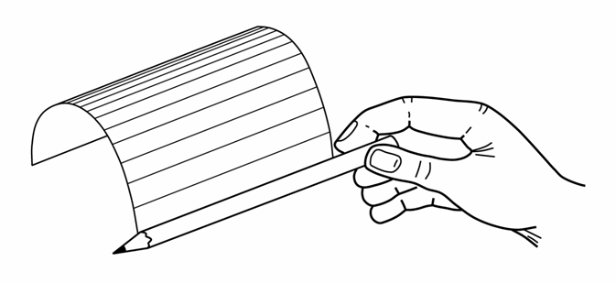
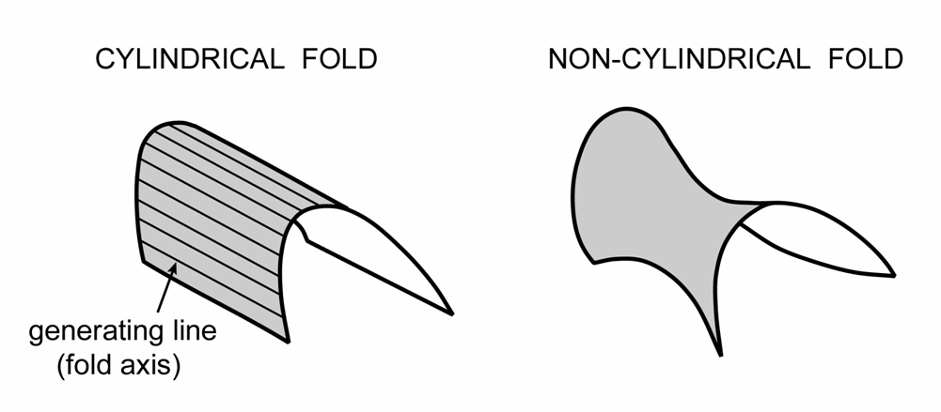
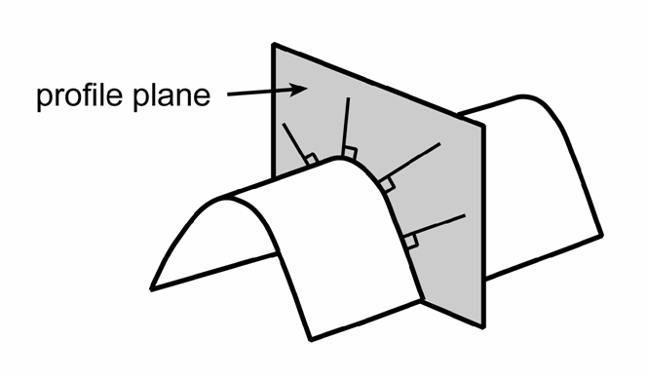
Essential geometric elements: fold axis/profile plane
Folds that can be generated by translating (no rotation) a straight line are described as cylindrical; folds that cannot be generated in this way are described as non-cylindrical
The line used to generate the fold is the fold axis
In cylindrical folds the fold shape on parallel cross section planes, whatever their orientation, is constant → we choose one of these orientations to describe fold geometry, and by convention that orientation is the plane that is perpendicular to the fold axis (profile plane)
Notes:
Real folds are not perfectly cylindrical, but they may be subdivided into parts that are approximately cylindrical. The use of stereograms to describe fold geometry relies on the folds being cylindrical over the area from which the data have been collected
Note that the fold axis is not defined at any particular location on the folded surface, that is, the fold axis is not just along the hinge
Two figures top redrawn by Steve Covey-Crump from Lisle, 2004, Geological Structures and Maps: A Practical Guide (3rd edition), p.29
Figure bottom by Steve Covey-Crump

Slide 4
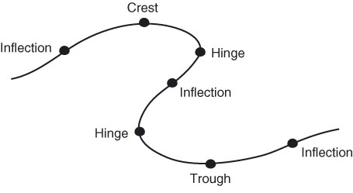
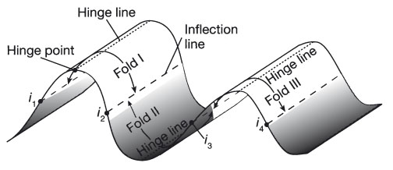
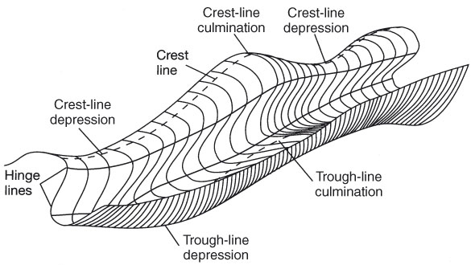
Essential geometric elements: parts of a fold
Variations in curvature around a fold define its essential elements: a line connecting points of maximum curvature is the hinge line; lines joining points of zero curvature (where the surface changes its sense of curvature) are inflection lines
The region around the hinge line is the hinge zone; the regions between hinge zones are the limbs
The line connecting the highest topographic points is the crest line, and that connecting the lowest points is the trough line. Non-cylindrical folds may have crest line and trough line culminations and depressions
Notes:
Some points to remember:
the hinge line is parallel to the fold axis but unlike the fold axis, it is at a specific location on the fold;
inflection lines separate different folds, that is, a single fold is the portion of the folded surface that lies between two adjacent inflection lines;
the crest line and trough line each only coincide with a hinge line if the fold has a vertical axial plane (for the definition of an axial plane, see Slide 6)
Figures from Twiss & Moores, p.277, 278

Slide 5
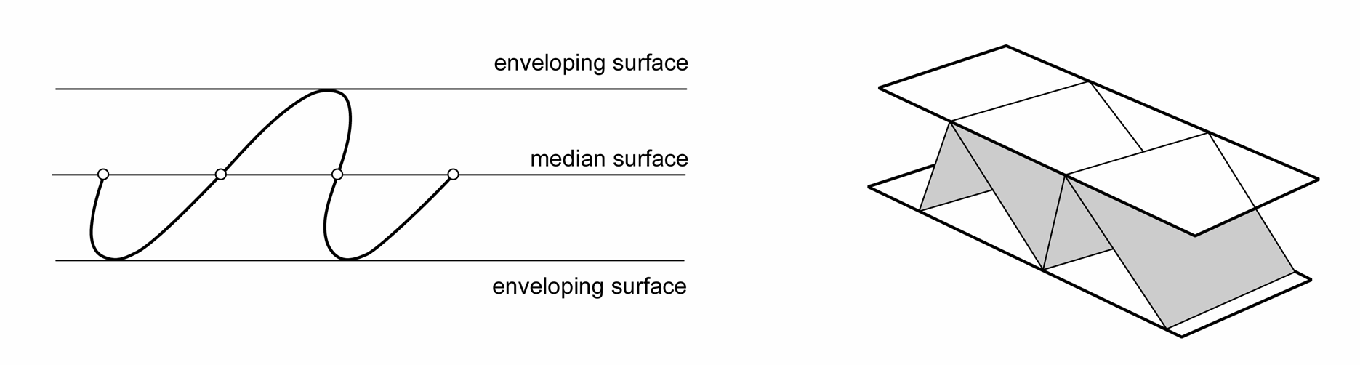
Essential geometric elements: enveloping surfaces
In a train of folds, the surface that contains the crest lines (or trough lines) is described as the enveloping surface. The dip of this surface is commonly called the sheet dip and is effectively the average dip of the folded surface
The surface containing all the inflection lines is described as the median surface. This need not be halfway between the two enveloping surfaces that are on either side of it
The enveloping and median surfaces are central to the notion of fold symmetry and fold scale
Notes:
Figure left redrawn by Steve Covey-Crump from Ragan, p.372
Figure right redrawn by Steve Covey-Crump from Lisle, 2004, Geological Structures and Maps: A Practical Guide (3rd edition), p.33

Slide 6
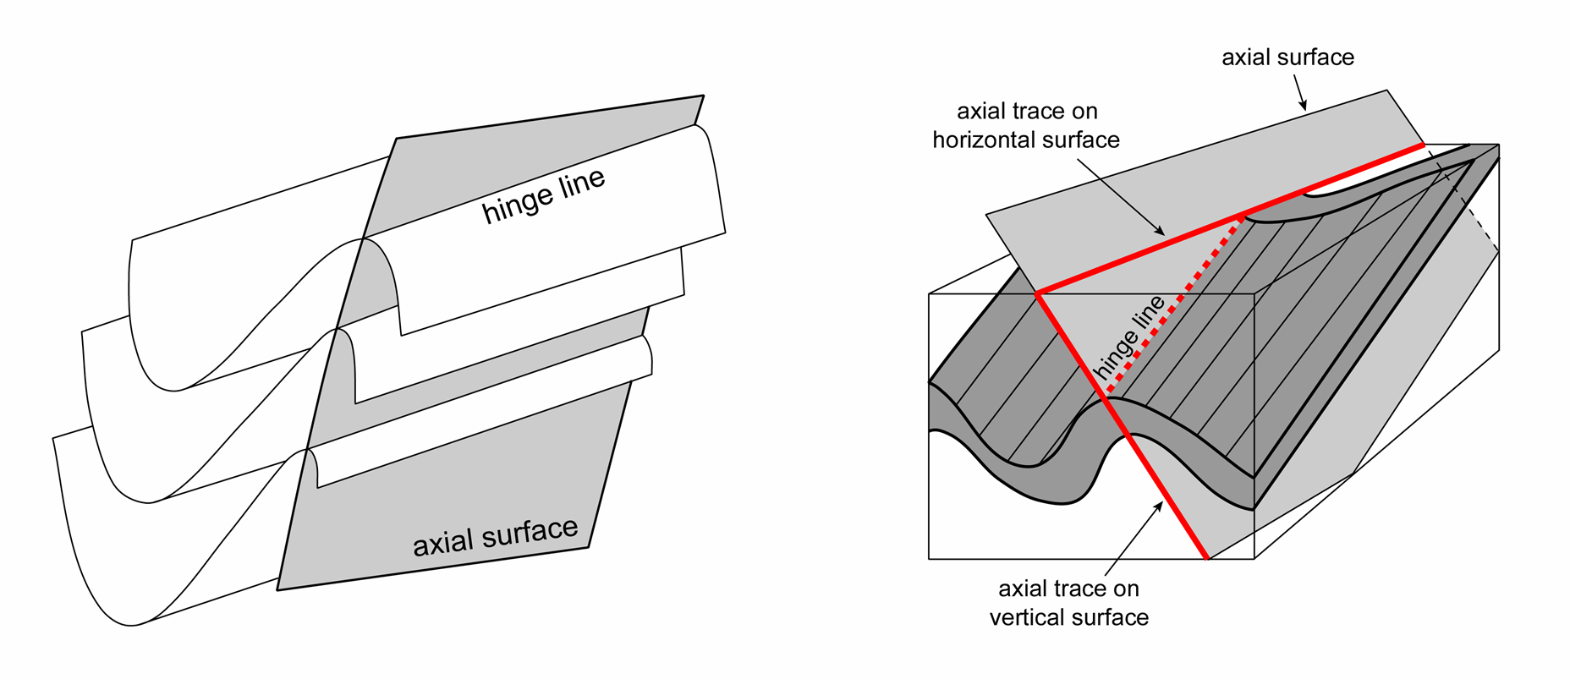
Essential geometric elements: axial surface
The surface that contains the hinge lines of a nested stack of folded surfaces is called the axial surface (axial plane if that surface is planar)
The line of intersection of the axial surface with any other surface of interest (usually the ground surface) is called the axial trace
Notes:
In principle, one could distinguish the hinge plane and the axial plane in the same way as the hinge line and fold axis are distinguished, that is, the hinge plane and axial plane are parallel with each other, but the former relates to a specific location (the hinge of the fold) whereas the latter does not (see notes to Slides 3 and 4)
Very important: on a geological map the plunge direction of the fold axis is not generally in the same orientation as the axial trace (it is ONLY in the same orientation if the axial plane is vertical or the fold axis is horizontal). Since the fold axis lies in the axial plane, on a stereogram it lies on the great circle that describes the orientation of the axial plane; hence the plunge direction of the fold axis can only be the same as the strike of the axial plane if the axial plane is vertical or the fold axis is horizontal (try it and see)
Figure left redrawn by Steve Covey-Crump from Lisle, 2004, Geological Structures and Maps: A Practical Guide (3rd edition), p.32
Figure right redrawn by Steve Covey-Crump from Twiss & Moores, p.280

Slide 7
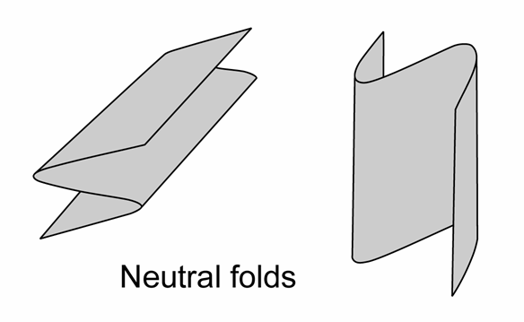
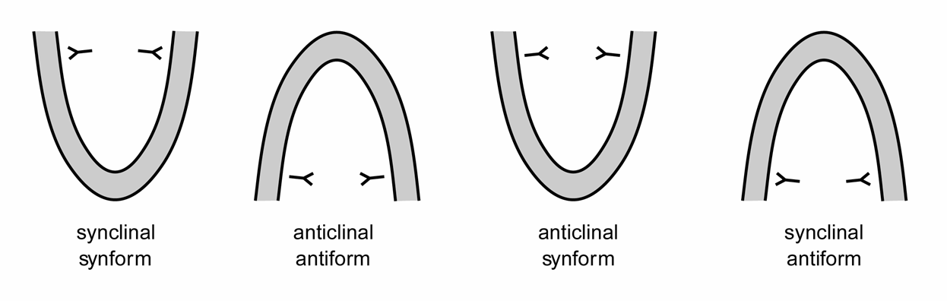
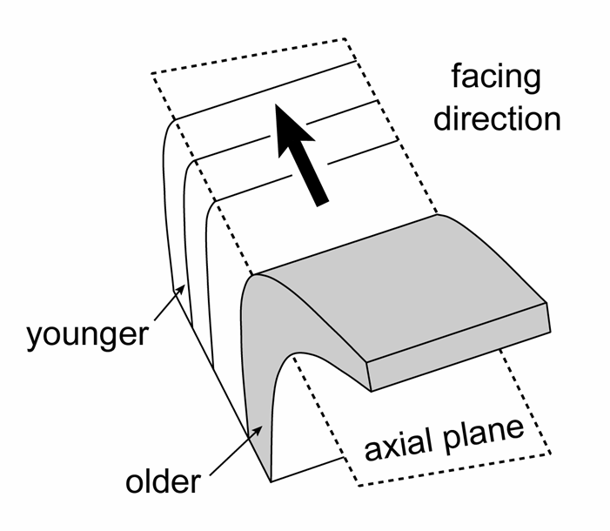
Essential geometric elements: antiform/synform
Folds that close down are synforms; folds that close up are antiforms. Folds that close horizontally are neutral folds
Folds with the youngest rocks in their cores are synclines; folds with the oldest rocks in their cores are anticlines
Folds face in the direction within their axial plane that they young. Hence, they face upwards, downwards or sideways. The fold to the right is an upward-facing anticline
Notes:
A fold is said to close in the direction that the limbs converge. Strictly, the direction of closure is the direction in which the limbs converge as seen within the plane that is at right angles to the hinge line (i.e., as seen within the profile plane)
Facing is an alternative terminology that is used to convey younging and in principle it gets around using the terms antiform/synform – an upward-facing anticline is an anticlinal antiform while a downward-facing anticline is an anticlinal synform
Figure left by Steve Covey-Crump
Figure top right redrawn by Steve Covey-Crump from Ramsay & Huber, p.310
Figure bottom right redrawn by Steve Covey-Crump from Lisle, 2004, Geological Structures and Maps: A Practical Guide (3rd edition), p.32

Slide 8
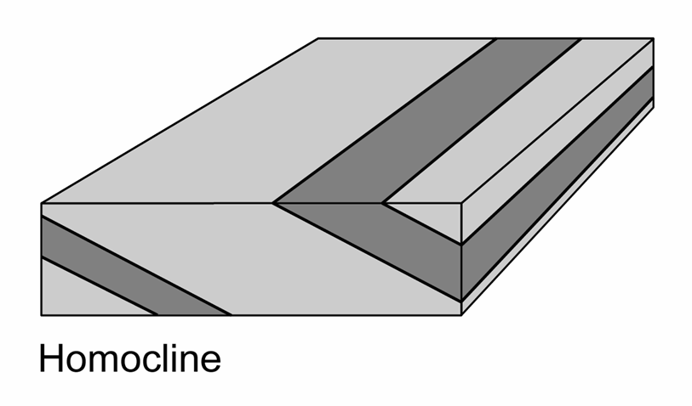
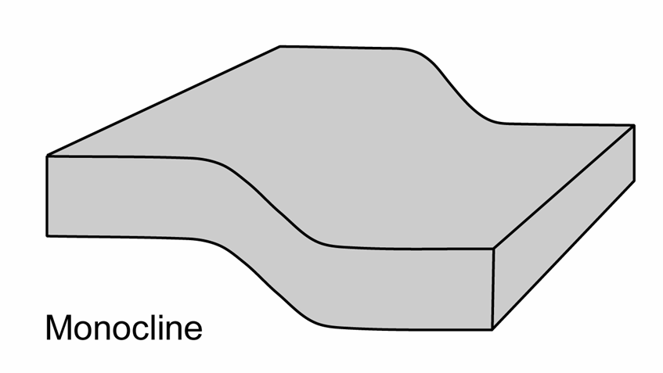
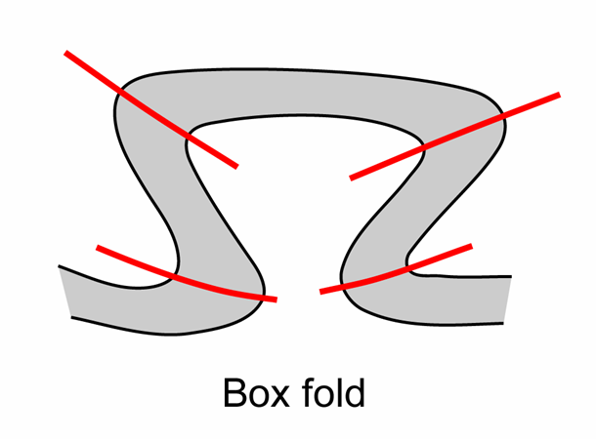
Essential geometric elements: other fold types
Other fold types include
Homoclines: uniformly tilted layering on a regional scale
Monoclines: fold pair with two long horizontal limbs connected by a short, inclined limb
Box folds: double-hinged fold, and kink folds: one half of a box fold (discussed further in Class 2)
Notes:
Two figures top redrawn by Steve Covey-Crump from Twiss & Moores, p.283
Figure bottom redrawn by Steve Covey-Crump from Fossen, p.258

Slide 9
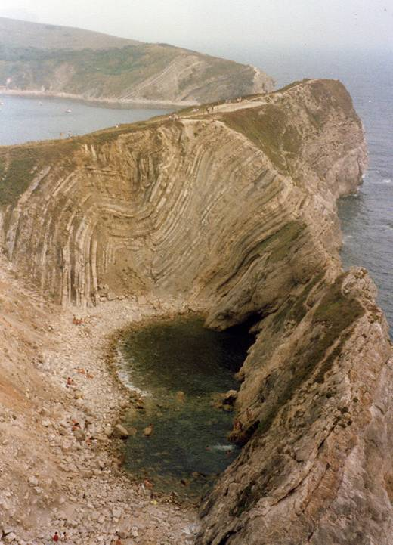
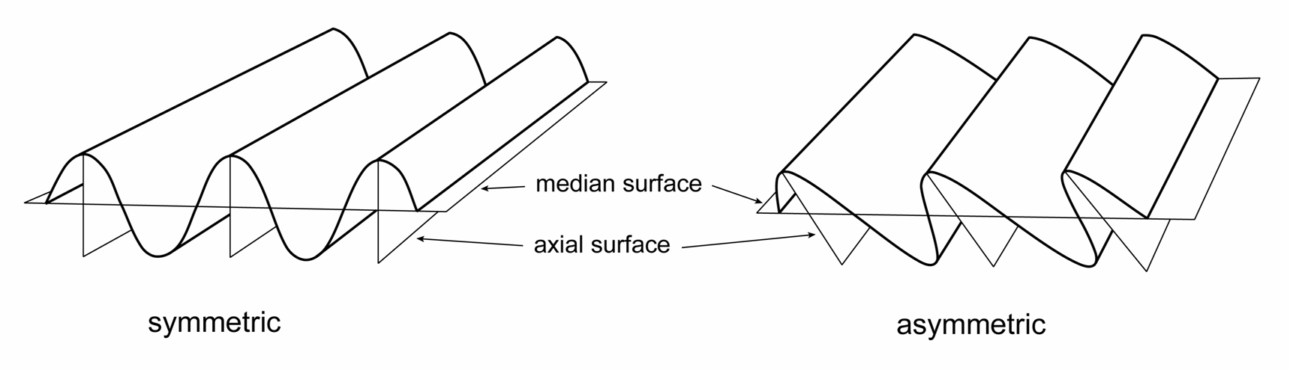
Fold symmetry 1
A fold is symmetric if:
  the median surface and the axial surface are perpendicular, and
  the median surface and the axial surface divide an antiform-synform pair into mirror-symmetric quarter waves (each limb is the same length)
If either of these conditions is not satisfied, then the fold is said to be asymmetric
Notes:
Note the spelling of asymmetry (one ‘s’ and two ‘m’)
Photo (Steve Covey-Crump): asymmetric fold at Stair Hole, Lulworth Cove, Dorset, formed during the Alpine orogeny
Figures bottom redrawn by Steve Covey-Crump from Ramsay & Huber, p.320

Slide 10
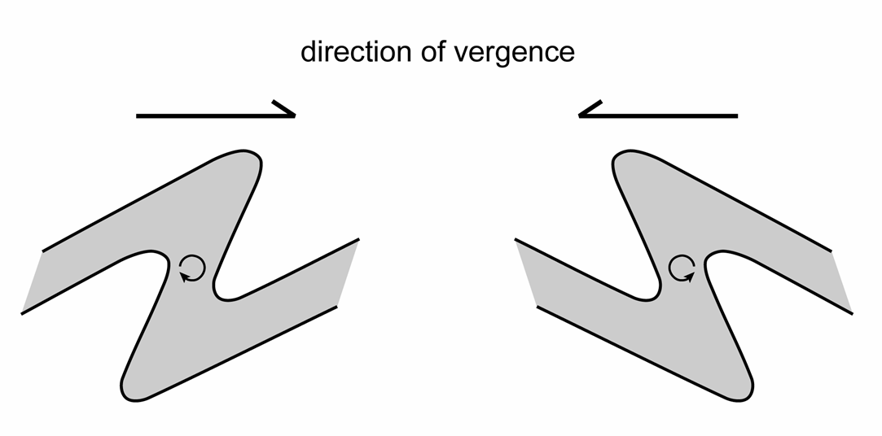
Fold symmetry 2
Asymmetric folds usually violate both conditions for symmetry, that is, the median surface and axial plane are not perpendicular, and the fold limbs are of unequal length
The shape of an antiform-synform pair in the profile plane (drawn with the short limb as the intermediate limb, and by convention looking down the fold axis) may then be described as being of S- or Z-asymmetry
Alternatively, we may use the concept of vergence:
the direction of vergence (a compass direction) is the horizontal direction within the profile plane that the top of the short limb must be rotated so that the short limb becomes parallel with the long limbs (= direction towards the antiform if you are on the long limb)
Z-fold (assuming we are looking down plunge)
Verge to the “right”
S-fold (assuming we are looking down plunge)
Verge to the “left”
Notes:
Whether an asymmetric fold pair has the appearance of S-asymmetry or of Z-asymmetry depends upon whether one is looking down the fold axis or up the fold axis (try it by drawing a ‘Z’ on a bit of paper – this looks like an ‘S’ if you look through the back of the paper). This means that for non-cylindrical folds in which the hinge-line passes through culminations and depressions so that the fold axis plunges first one way and then 180° in the other direction, congruent minor folds on the same limb may be of S-asymmetry in one place but Z-asymmetry in another. The direction of vergence does not suffer from this descriptive untidiness – all congruent minor folds on the same limb verge in the same direction. Consequently, vergence is favoured over S/Z terminology by many structural geologists (see Bell, 1981, Journal of Structural Geology 3: 197-202, https://doi.org/10.1016/0191-8141(81)90015-8). The S/Z terminology is, however, intuitively simpler for the novice structural geologist and so has wide currency – for a comments on when it might be preferable to use the S/Z approach rather than vergence and vice versa, see Weijermars, 1985, Geologische Rundschau 74: 611-622, https://doi.org/10.1007/BF01821216
Figure by Steve Covey-Crump

Slide 11
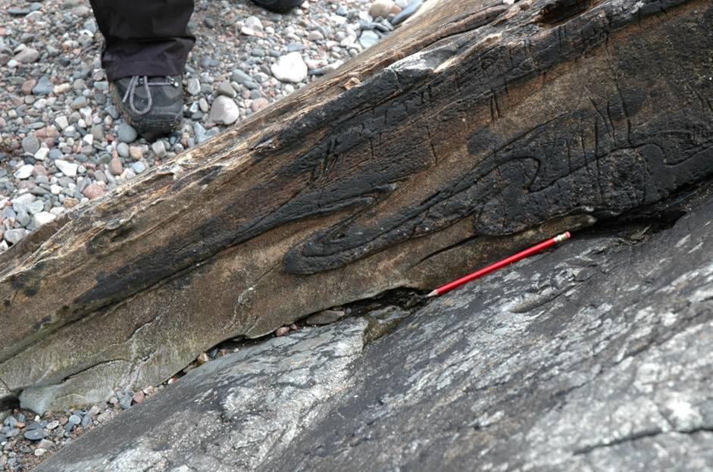
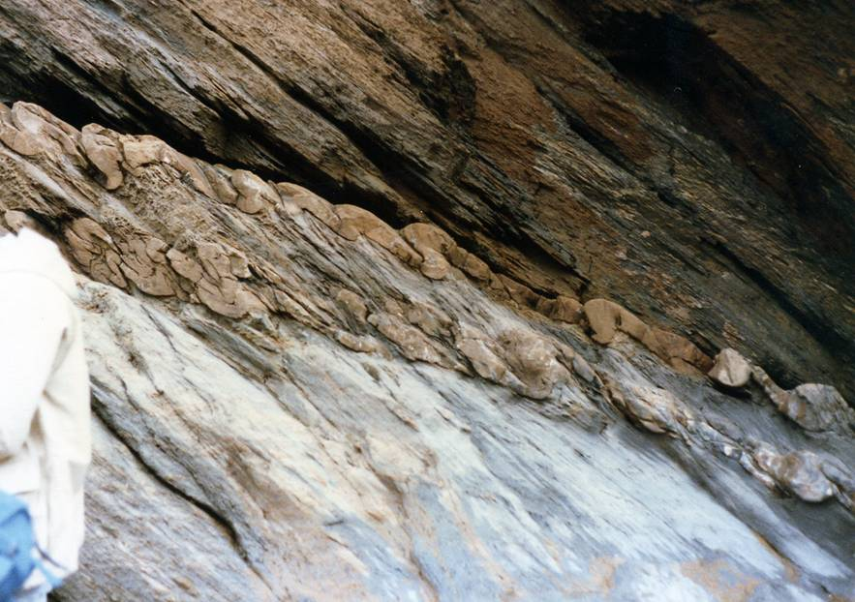
Fold symmetry 3
Asymmetric folds verging to the right; Z-asymmetry in this viewing direction
Asymmetric folds verging to the left; S-asymmetry in this viewing direction
NB. Direction of vergence is normally indicated as a compass direction rather than as left or right
Notes:
Photo left (Steve Covey-Crump): the shore section at Onich, Scotland
Photo right (Steve Covey-Crump): Hele Bay, near Ilfracombe, Devon

Slide 12
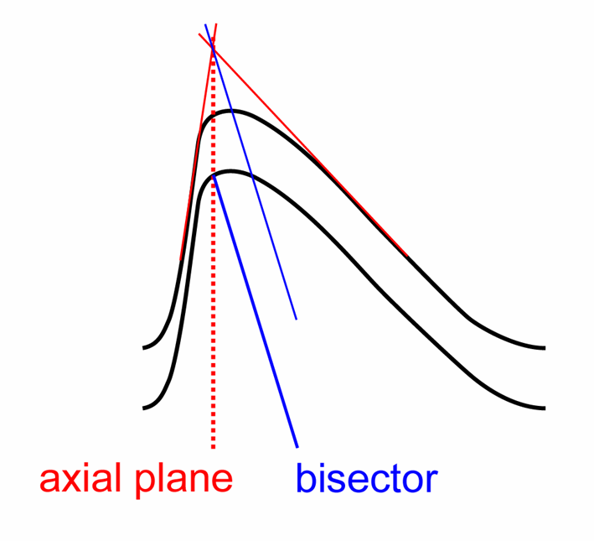
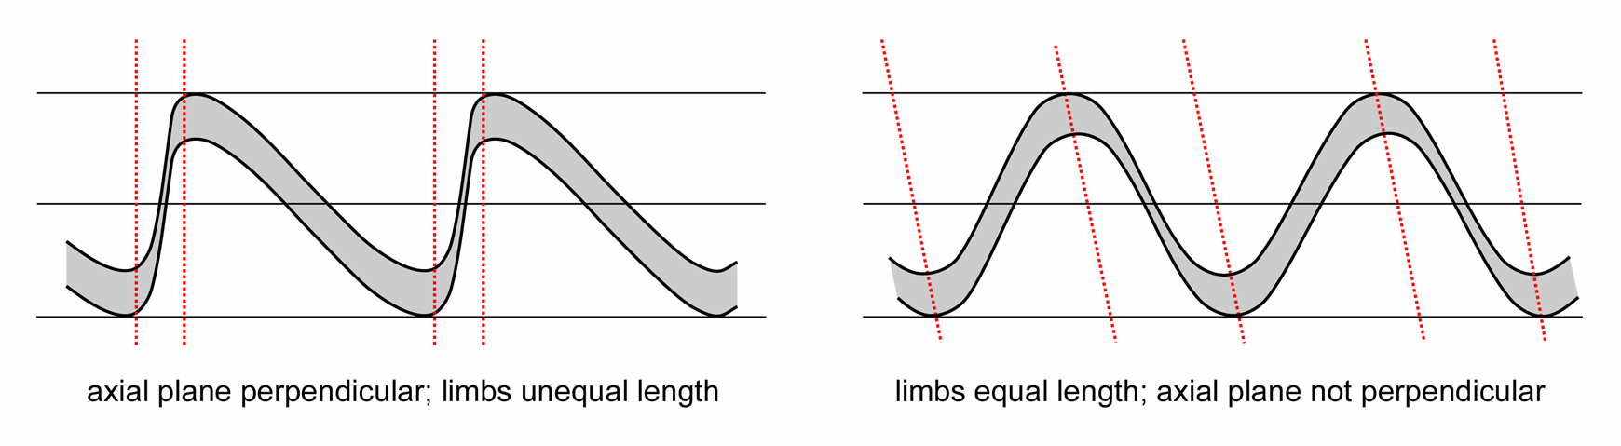
Fold symmetry 4
Asymmetric folds which violate only one of the conditions for symmetry arise when the limbs are of different thickness
In such cases, the axial plane does not bisect the angle between the limbs (as seen in the profile plane), and it becomes convenient to refer to the bisector, that is, the plane that does bisect this angle and which also contains the hinge line of the folded surface
Notes:
Since the definition of an axial surface requires at least two nested folded surfaces (see Slide 6), it follows that when you have a single folded surface, the axial plane is not defined. In this situation the bisector is all that can be specified. This situation most commonly arises in artificial Structural Geology classwork exercises; in nature if you have a folded bed, the top and bottom of the bed form two nested surfaces that you can use to define the axial surface
Figures by Steve Covey-Crump

Slide 13
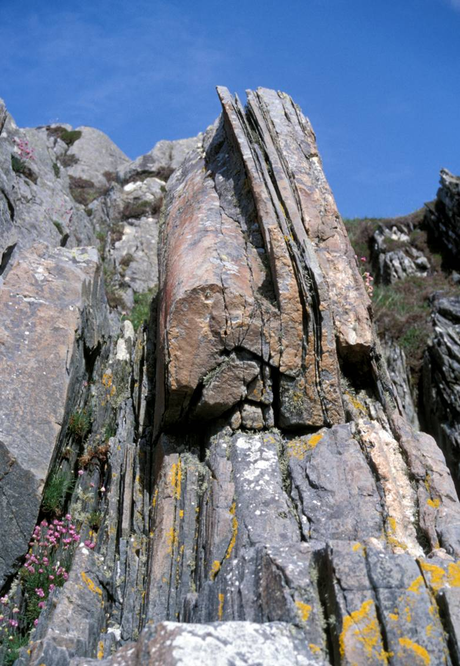
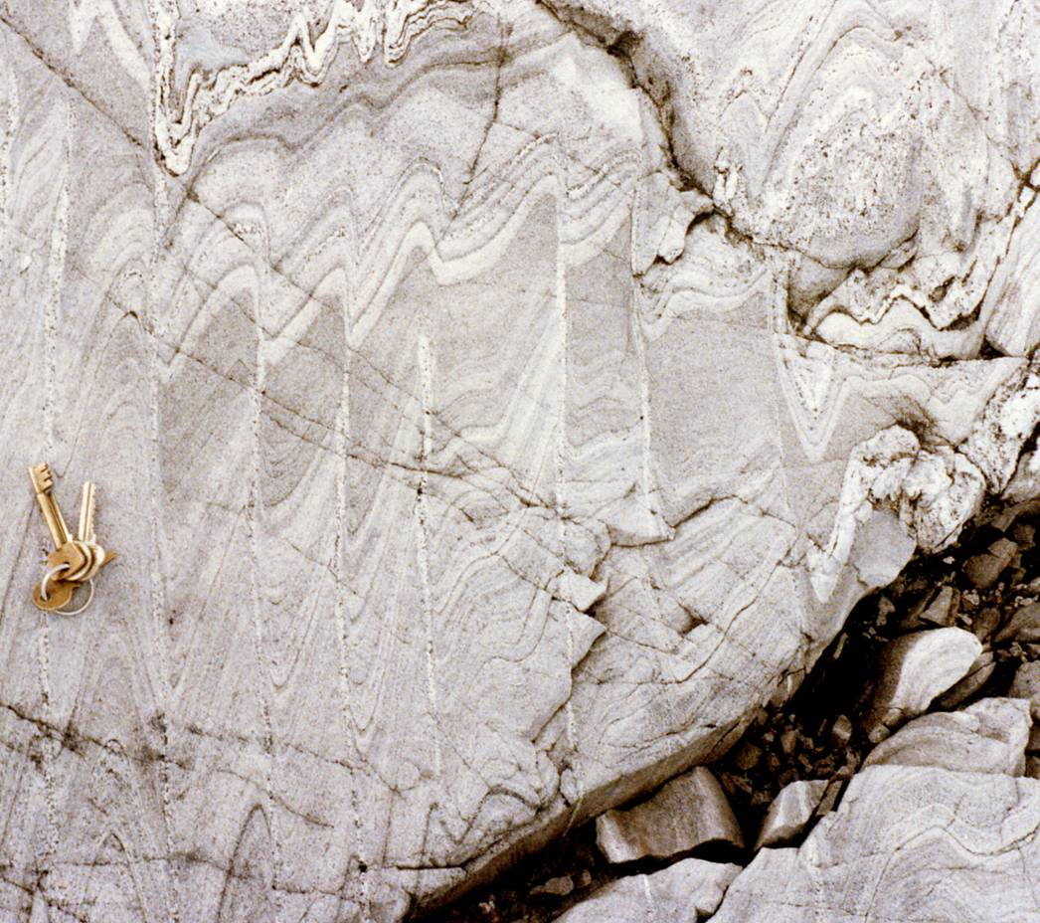
Fold symmetry 5
Asymmetric folds with very different limb thicknesses
Notes:
Photo left (Steve Covey-Crump): a minor fold at Uisken in the Moine metasediments on the island of Mull, Scotland
Photo right (Steve-Covey-Crump): small scale folds in Moine metasediments, east end of Loch Monar, Scotland. The locality where this photo comes from is where John Ramsay established the geometric features of fold interference patterns (refolded folds – see the last few slides of the Class 2 presentation). The locality is described in Strachan et al., 2010, An Excursion Guide to the Moine Geology of the Northern Highlands of Scotland, (p.153-161, particularly locality 8.3)

Slide 14
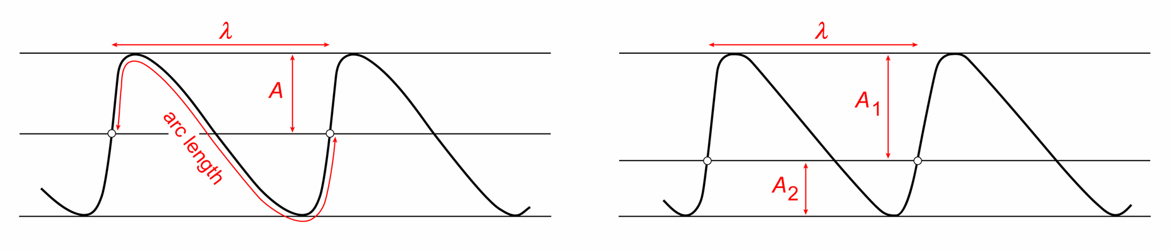
Fold scale
The scale of folds is characterized by their amplitude (A) and wavelength (λ) as defined with reference to the enveloping surfaces and median surface. (If the median surface is not midway between the enveloping surfaces, then two values of amplitude are required)
Two other length scales are important when it comes to considering how folds form:
  arc length, defined as the distance measured along the folded surface between two inflection points or (as illustrated above) twice that distance, and
  layer thickness
Notes:
Subtle variations in the definitions of amplitude and wavelength have arisen between different authors, largely because real folds are not perfectly cylindrical and so decisions have to be made about how to apply formal mathematical definitions (see Fig. 1 and Fig. 2 of Adamuszek et al., 2011, Journal of Structural Geology 33: 1406-1416, https://doi.org/10.1016/j.jsg.2011.06.003)
Figures by Steve Covey-Crump based on Ragan, p.372

Slide 15
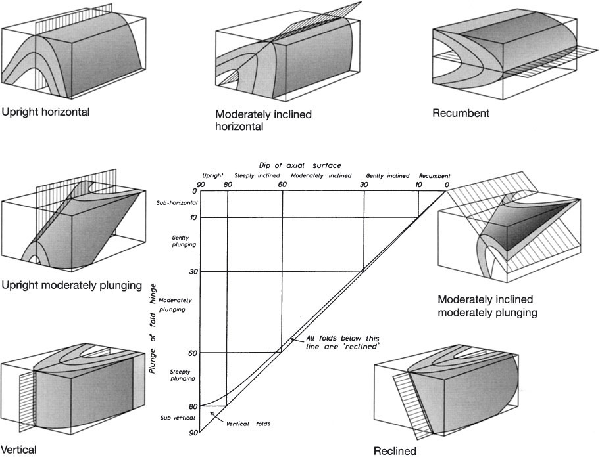
Fold attitude 1
The attitude of folds is described with reference to the plunge of the fold axis and the dip of the axial plane. Various adjectives are often applied
Notes:
Vertical folds are those in which the fold axis (and hence the axial plane) is vertical; reclined folds are ones in which the plunge/plunge direction of the fold axis is the same as the dip/dip direction of the axial plane
Figure from Twiss & Moores, p.282

Slide 16
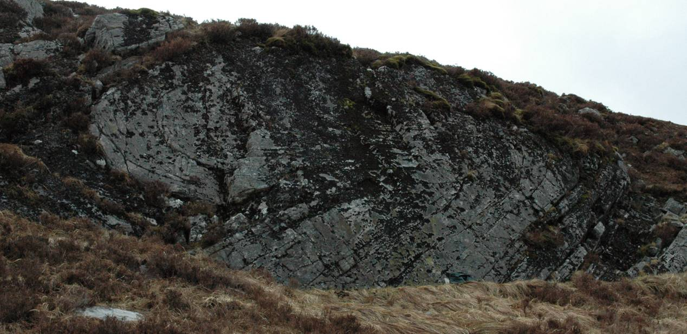
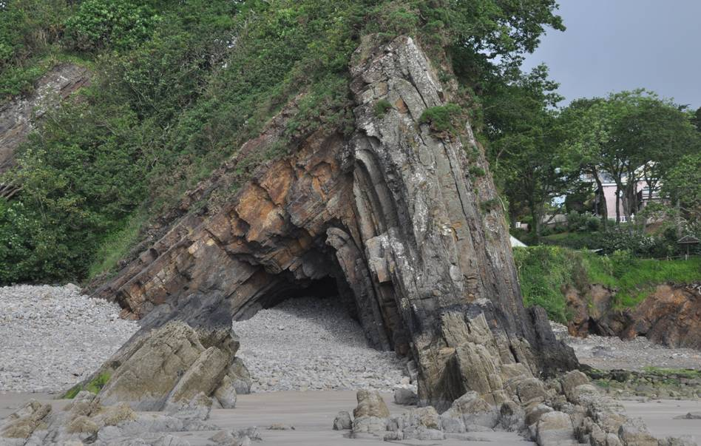
Fold attitude 2
Gently inclined, gently plunging
axial plane
fold axis
Upright/steeply inclined, gently plunging
Notes:
Photo bottom left (Steve Covey-Crump): Ladies Cave anticline, south of Saundersfoot harbour, Pembrokeshire
Photo top right (Steve Covey-Crump): a fold on the slopes north of Kinlochleven

Slide 17
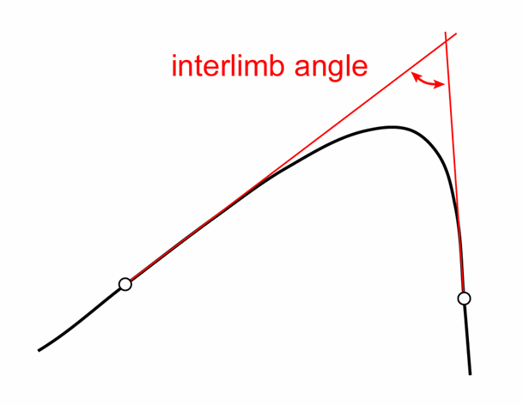
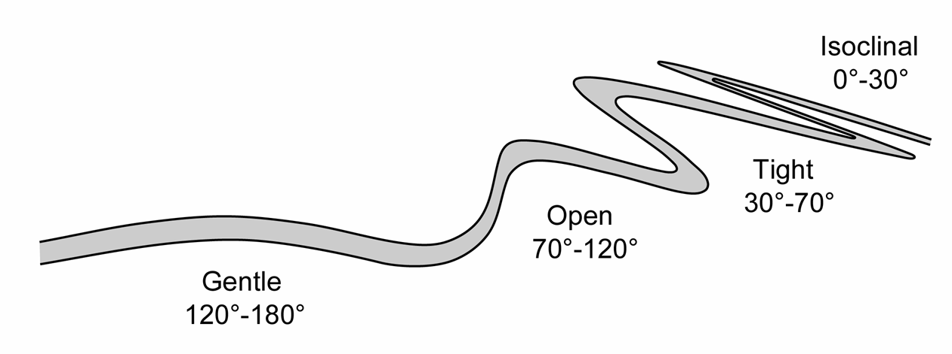
Fold shape 1
Various quantitative measures of fold shape have been defined:
  Fold aspect ratio: amplitude ÷ half wavelength
  Fold bluntness: a measure of how rounded or angular the hinge is
  Fold tightness: defined by the interlimb angle (the minimum angle between the limbs as measured in the profile plane, that is, the angle between the lines tangent to the inflection points of the fold in that plane)
Quantitative measures of this kind are rarely used but the features that they describe are commonly noted using adjectives such as concentric, chevron, isoclinal
Notes:
Formal definitions of these three measures may be found in the textbooks by Twiss & Moores (p.284-285) and by Ragan (p.373-374)
Note that the use of half wavelength in the definition of fold aspect ratio makes sense if you recall that a fold is defined as that part of the curved surface lying between two adjacent inflection lines (see point 2 in the notes to Slide 4). Amplitude is defined that way, but wavelength is twice this distance (see figure on Slide 14)
Figure left (redrawn by Steve Covey-Crump from Ragan, p.371) showing the formal definition of ‘interlimb angle’
Figure right (redrawn by Steve Covey-Crump from Fossen, p.262) showing terms used for fold tightness

Slide 18
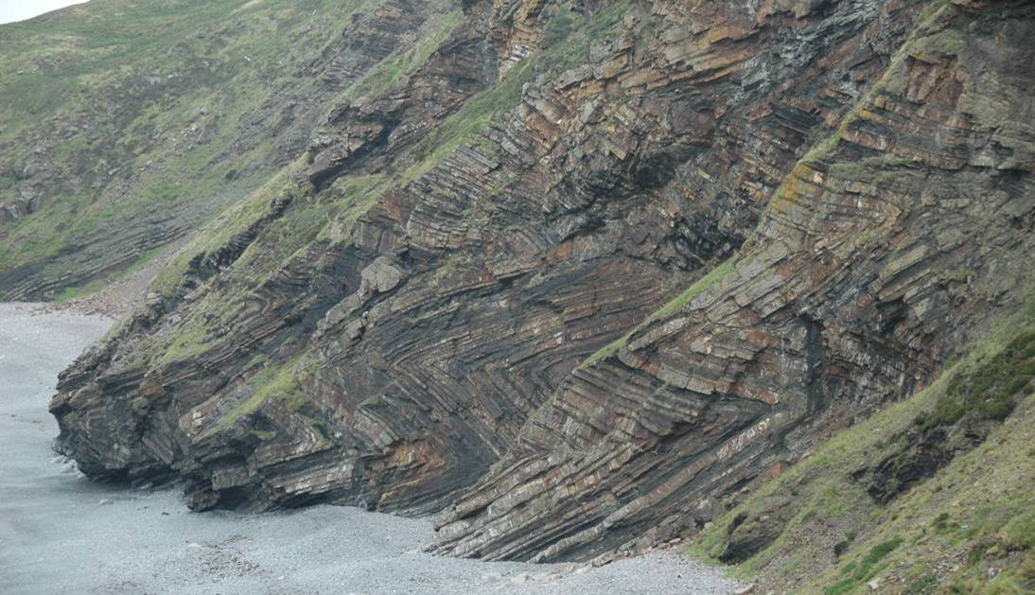
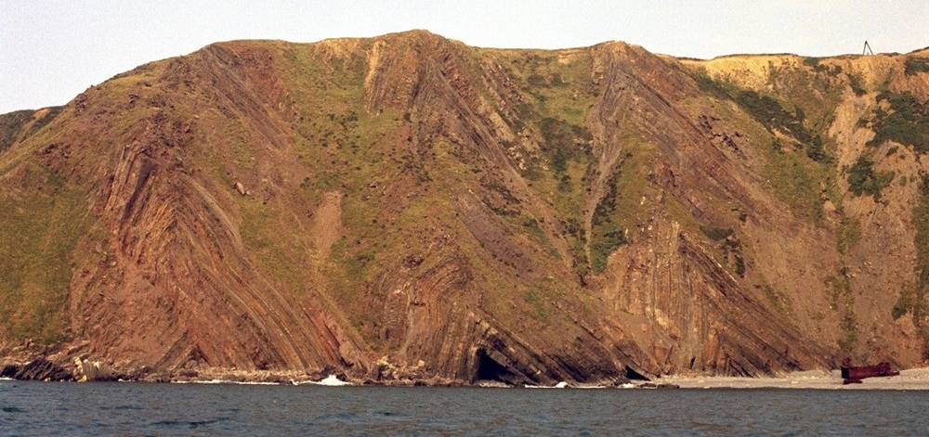
Fold shape 2 (fold bluntness)
Chevron folds (very angular hinges)
Notes:
Photo top left (Steve Covey-Crump): Millook Haven, North Devon
Photo bottom right (BGS image database: geoscenic.bgs.ac.uk/asset-bank/action/viewHome, image P211581): upright chevron folds, Gunpath Beach, near Hartland Quay, North Devon

Slide 19
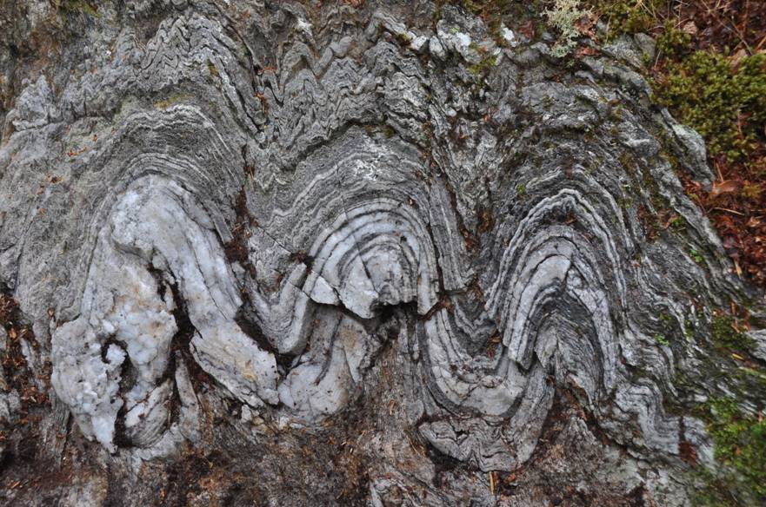
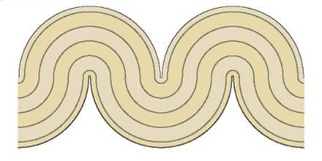
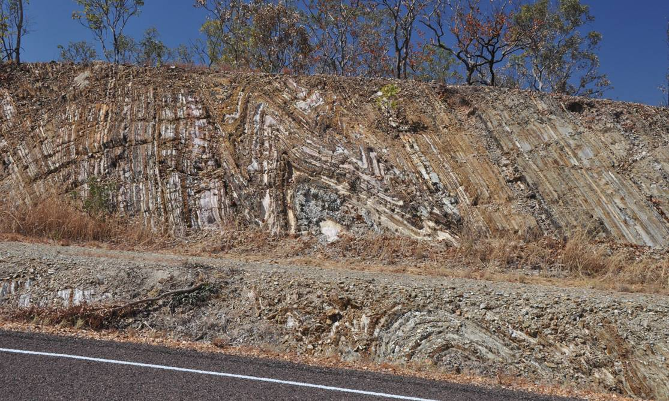
Fold shape 3 (fold bluntness)
Concentric folds (hinge / limbs are arcs of a circle)
Rounded hinge folds (approaching concentric)
Note that within these folds, some layers have chevron fold shape (top) while others are much more rounded (bottom on the road-side)
Notes:
Photo top left (Steve Covey-Crump): folded quartzites within a dominantly pelitic unit, Kinlochleven
Figure top right from Fossen, p.258
Photo bottom right (Steve Covey-Crump): folds within the South Alligator Group (~1900 Ma), Kakadu Highway, south of Darwin, Australia

Slide 20
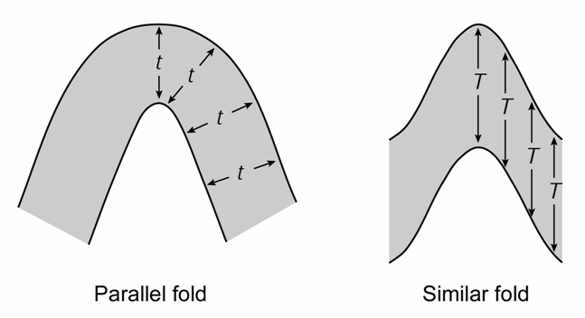
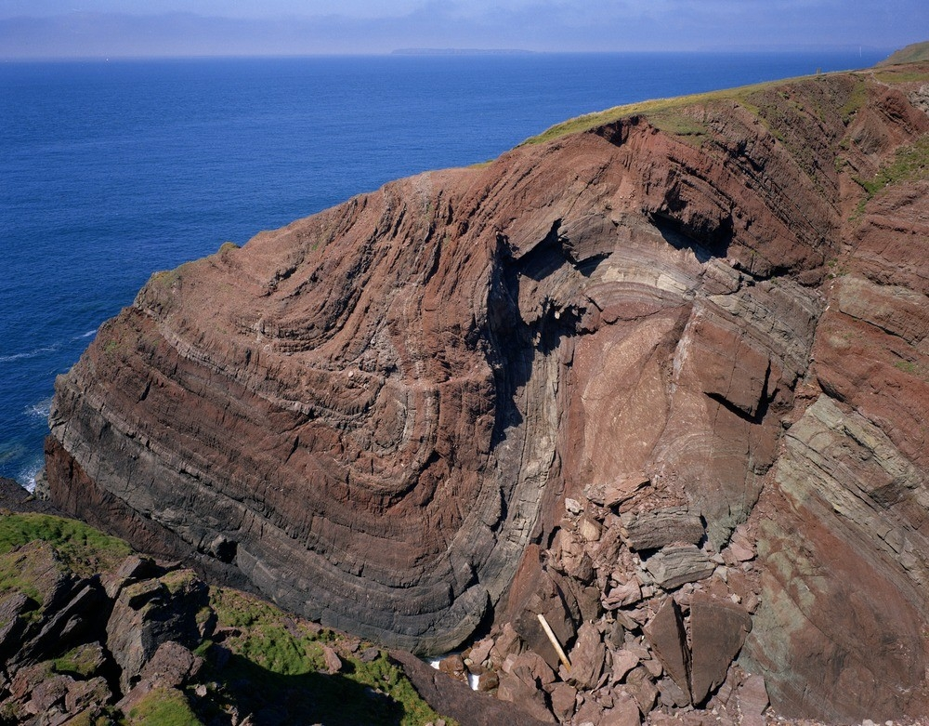
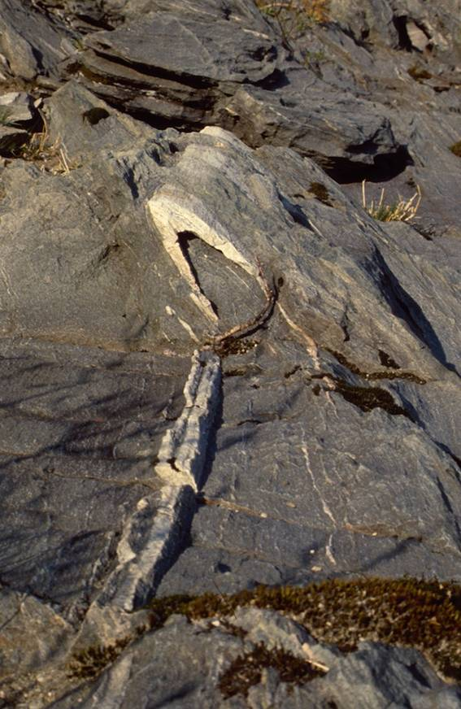
Fold classification by layer thickness variations 1
Parallel folds (below left) have constant orthogonal layer thickness around the fold
Similar folds (below right) have constant layer thickness parallel to the axial trace
Notes:
The variation in thickness of a layer around a fold can indicate the mechanism by which the fold formed and so this variation has been subject to a particularly thorough analysis
Figure top right by Steve Covey-Crump
Photo bottom left (BGS image database: geoscenic.bgs.ac.uk/asset-bank/action/viewHome, image P006697): parallel folds at St. Ann’s Head, Pembrokeshire (Old Red Sandstone)
Photo bottom right (Fossen (1st edition), p.222): similar fold from Bergen, Norway. The fold is also isoclinal (it has a small interlimb angle so that the limbs are nearly parallel – see figure on Slide 17). Similar folds are very commonly isoclinal

Slide 21
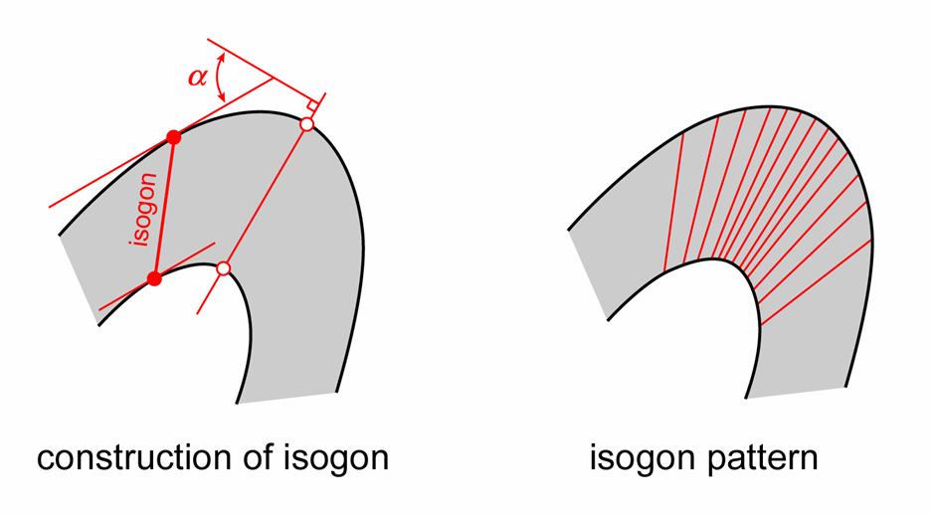
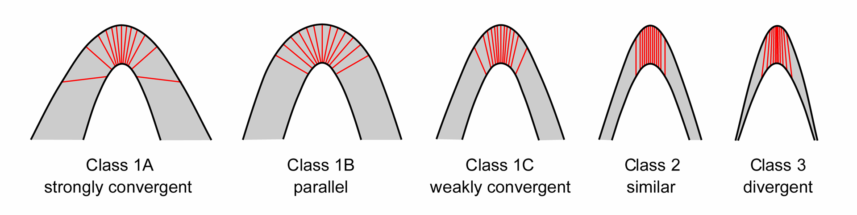
Fold classification by layer thickness variations 2
A more rigorous treatment utilizes the concept of a dip isogon, which is the line connecting points of equal dip on either side of a folded layer (in the profile plane)
Based in dip isogons we can distinguish five different classes of fold – parallel folds and similar folds are two of these
Notes:
Which class of fold is formed depends in part upon the mechanical properties of the layer being folded (discussed further in Class 2). For folded multilayers containing interbedded units of very different mechanical properties (e.g., interbedded sandstones and mudstones), the class of fold may vary from one layer to the next
There are some special case situations where the classification scheme doesn’t work (see Ramsay and Huber, Fig.17.13)
Figure top by Steve Covey-Crump
Figure bottom redrawn by Steve Covey-Crump from Ramsay, 1967, Folding and Fracturing of Rocks, p.365

Slide 22
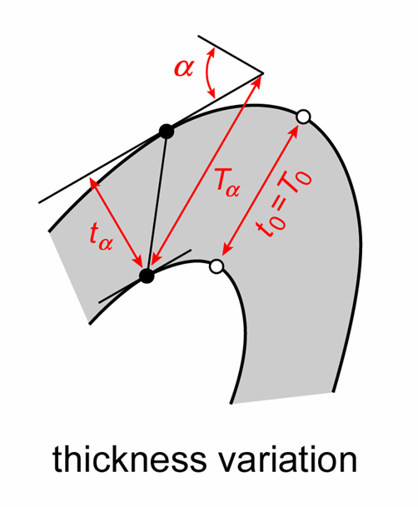
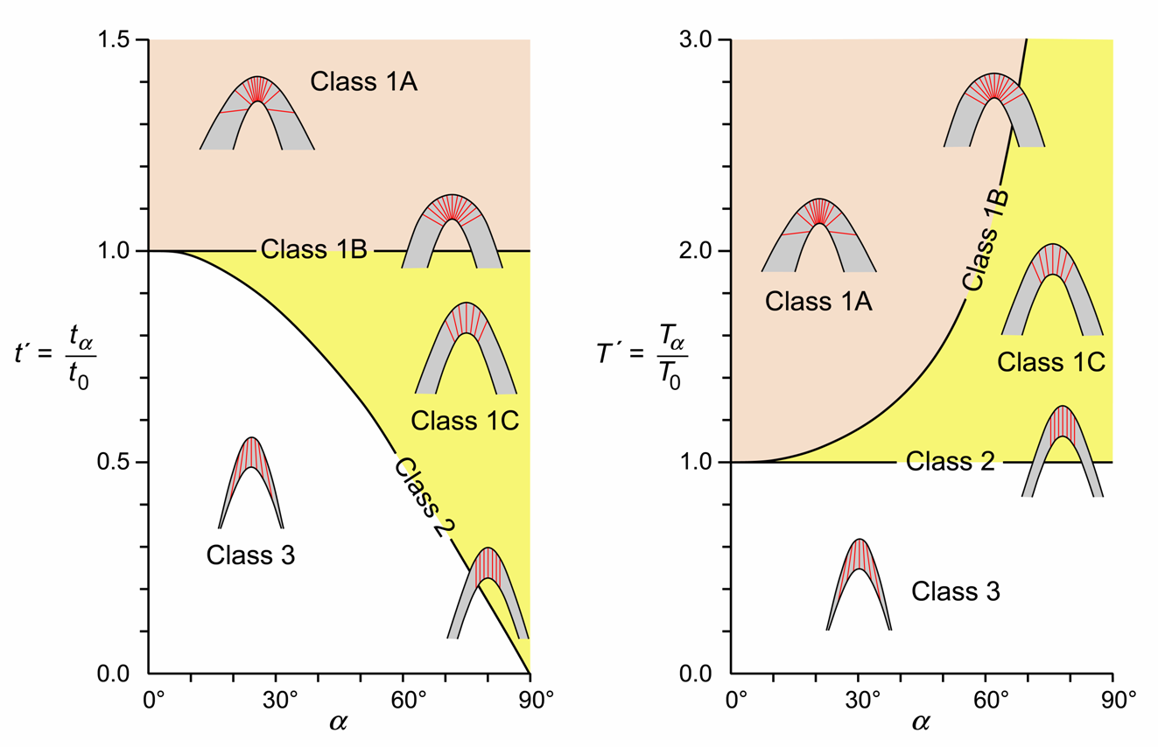
Fold classification by layer thickness variations 3
By plotting orthogonal thickness (t_{α}) ÷ orthogonal thickness in the hinge (t₀) vs. α one can distinguish the different fold classes graphically (below left)
Alternatively, one can do this by plotting thickness parallel to the axial plane (T_{α}) ÷ thickness parallel to the axial plane in the hinge (T₀) vs. α (below right)
Notes:
As you work around the fold away from the hinge, α and t_{α}/t₀ (or T_{α}/T₀) change and so the fold plots as a line on such graphs
On the orthogonal thickness plot (the left graph on right figure), Class 1B folds (parallel folds) plot as a horizontal straight line because the orthogonal thickness of these does not vary around the fold. On the axial plane thickness plot (the right graph on right figure), Class 2 folds (similar folds) plot as a horizontal straight line because the axial plane thickness of these does not vary around the fold
There are some more sophisticated variants of the plots shown on this slide which use the same measurements (see Ragan, p.386-397). Perhaps the best of these was developed by Lisle (Lisle RJ, 1997, A fold classification scheme based on a polar plot of inverse layer thickness, in: Sengupta S (editor) Evolution of Geological Structures in Micro- to Macro-scales, p.323-339; for an accessible description, see Ragan, p.388ff). These schemes allow information to be extracted about the amount of shortening and mechanical properties of the layer during folding (see Ragan, p.397ff.)
For those doing a field-based 3rd year project where there are folds in your field area, it is well worth carrying out such an analysis. If it is not obvious how to do this from the figures on this and the previous slide, then see Ramsay & Huber (p.348ff.) for a straightforward outline of the method and some worked examples. I have also put a worked example on the Canvas site accompanying this PowerPoint presentation. The measurements are best made in the field but can also be made from a photograph if you have taken the photo looking along the fold axis
Figure left redrawn by Steve Covey-Crump from Ragan, p.384
Figure right by Steve Covey-Crump based on Ramsay, 1967, Folding and Fracturing of Rocks, p.366

Slide 23
Summary of key geometric descriptors
The essential features that must be described (being quantitative whenever possible):
  Antiform/synform, anticline/syncline, symmetry, scale (wavelength, amplitude)
  Orientation of fold axis (plunge / plunge direction)
  Orientation of axial plane (strike / dip)
  Orientation of representative limbs (strike / dip of limbs at the inflection lines)
  Interlimb angle
  Orientation of bisector (strike / dip)
Additional features useful for interpreting the mechanism of fold formation include:
  Fold hinge shape
  Layer thickness variations (parallel/similar or a full isogon analysis)
  Mechanistically significant features (to be discussed in Class 2) including the presence of slickolites, outer arc tension gashes, etc.

Slide 24
Congruent Minor Structures
Notes:
Congruent minor structures are small-scale structures that form at the same time as a larger scale structure, and which have a geometry that is systematically related to the geometry of that larger scale structure. Here we consider the suite of congruent minor structures and fabrics that form during folding; in later classes we will consider congruent minor structures that form around faults and shear zones. Obtaining an intuitive understanding of the geometry of congruent minor structures is absolutely essential for working out how to integrate relatively small-scale structural observations into a larger scale tectonic story. We will consider such syntheses of structural observations in last three classes of this unit, but what I will say then will not make much sense if you haven’t understood congruent minor structures first

Slide 25
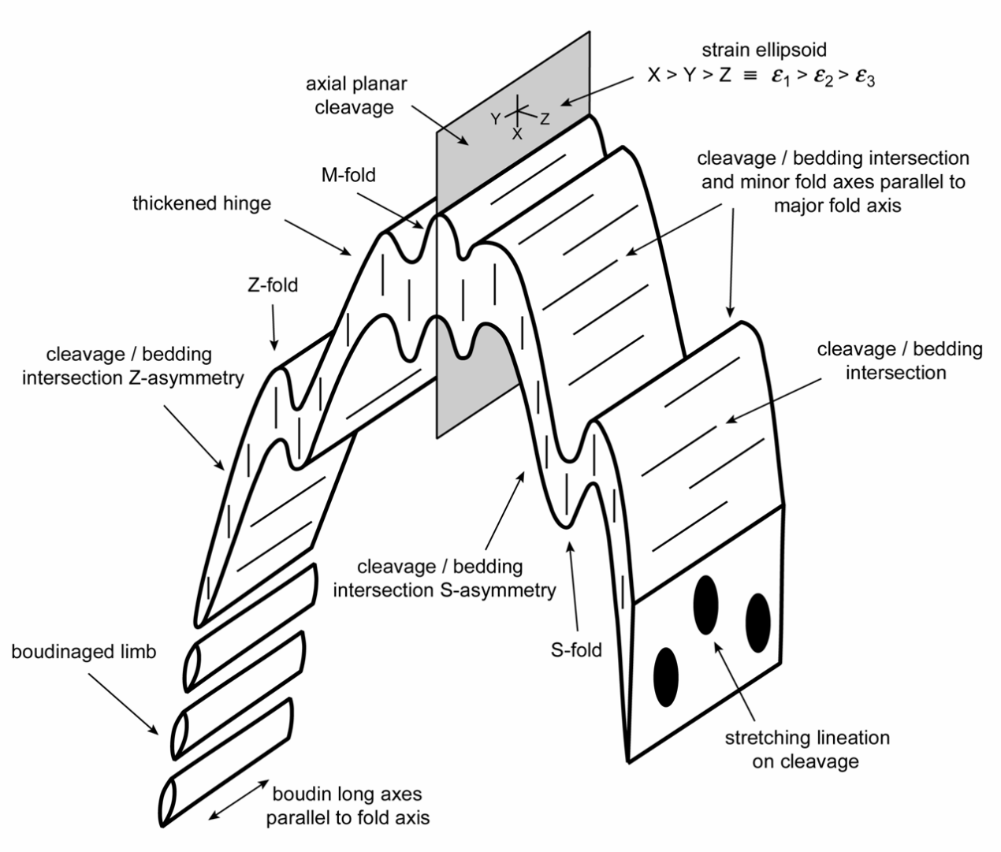
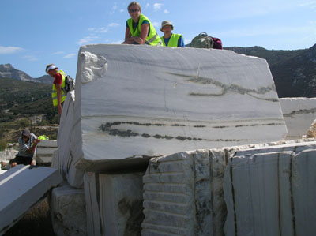
Congruent minor structures
The large-scale geometry of a fold may be established by examining small-scale structures around it
Primary structures including sedimentary structures and
fabrics in igneous rocks (e.g., flow banding) provide an indication of orientation (particularly way-up) at the time the rock was formed
Secondary structures produced by deformation (e.g., minor folds, cleavage/schistosity)
Notes:
The reference to the strain ellipsoid on this figure is for completeness – we will discuss strain in Class 3
Figure by Steve Covey-Crump based on an original by Ernie Rutter
Photo (users.ugent.be/~melburg/Excursion/Excursion2009/SantoriniNaxos2009.html): boudinaged fold limbs, marble quarry, Naxos

Slide 26
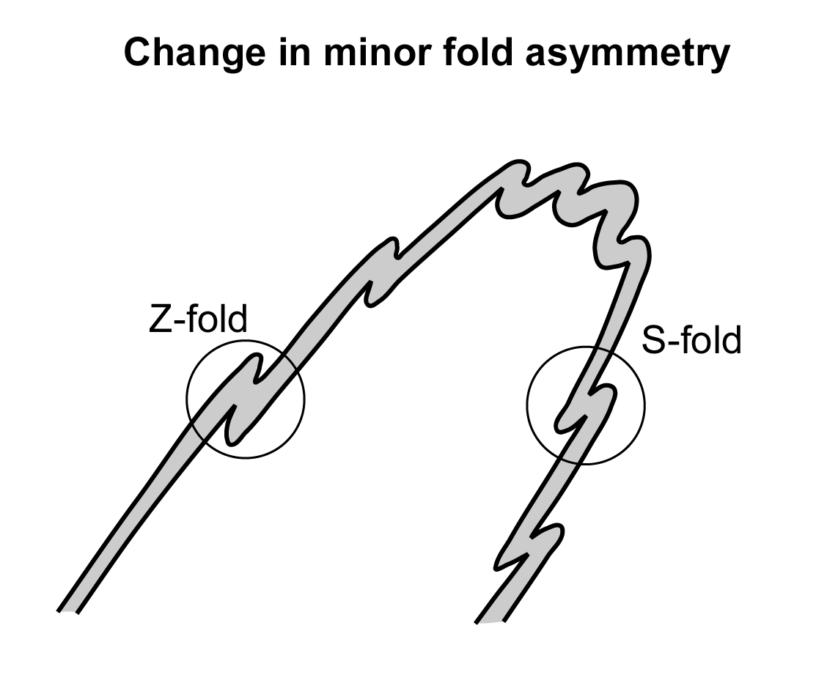
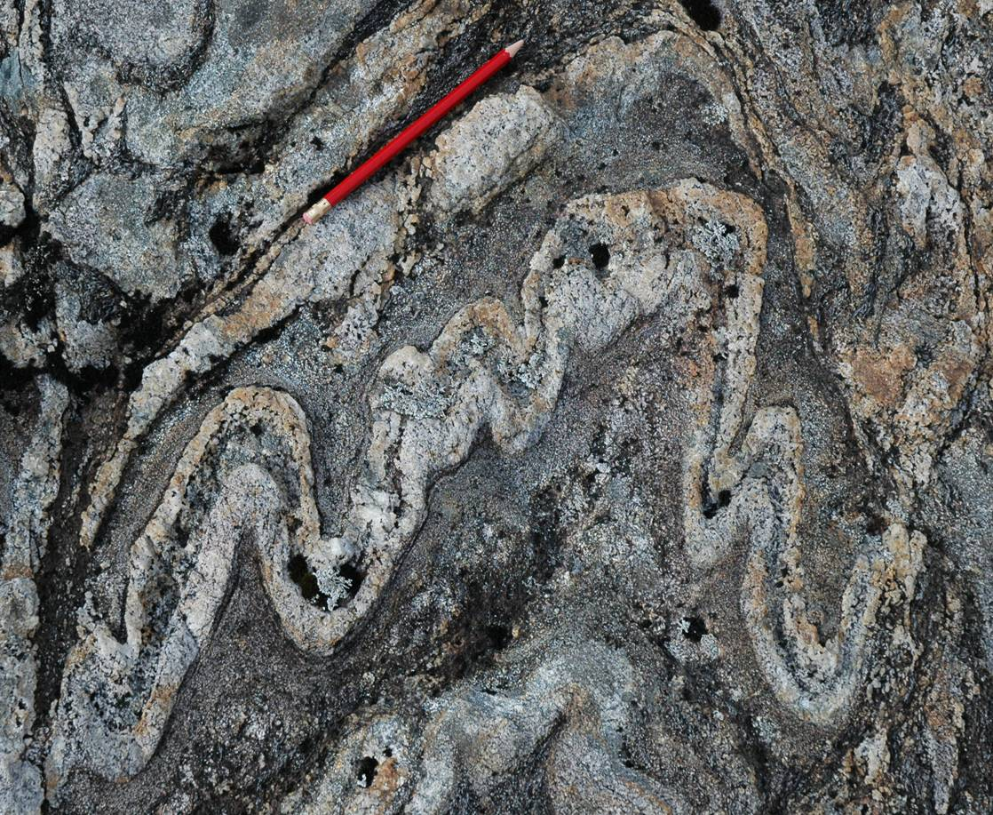
Minor folds
Around large-scale folds, frequently there are smaller, asymmetric minor folds (sometimes described as drag folds or parasitic folds)
The direction of vergence of these minor folds changes across the fold hinge and so minor fold vergence (sense of asymmetry) may be used to locate this hinge
The fold axis of these minor folds is the same as the fold axis of the larger scale fold
Notes:
The term ‘drag fold’ implies a rather dubious theory about how these folds form. ‘Parasitic fold’ is more general, and it also conveys the sense that these folds have formed on a larger scale structure (the term ‘minor fold’ does not quite capture this meaning)
Figure left by Steve Covey-Crump
Photo right (Steve Covey-Crump): folded Moine schists, near Glenfinnan, Scotland

Slide 27
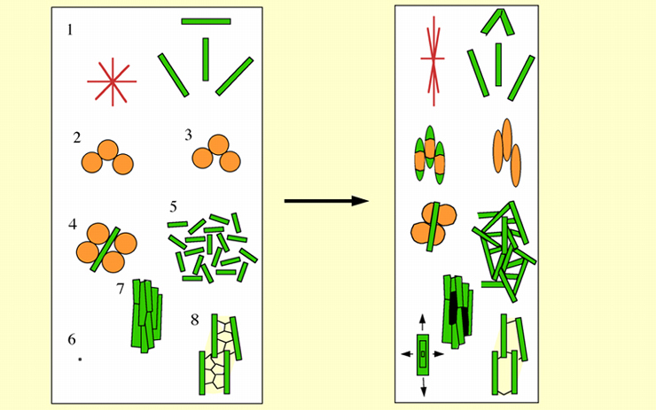
Formation of planar and linear fabrics
During deformation several different processes may result in the formation of a planar fabric or a lineation
Passive rotation of elongate crystals
Mineral shape change by solution and precipitation in strain shadows
Mineral shape change by plasticity
Combination of 1 and 2 in polymineralic aggregates
Grain growth of micas parallel with their basal planes; grains that are oriented parallel with the foliation grow to greater lengths
Oriented nucleation and growth of new grains
Mimetic growth of elongate grains due to restrictions on growth direction imposed by a pre-existing foliation
Restricted growth parallel with platy minerals
Notes:
27
The development of foliations and lineations is an important topic (mapping foliations and lineations is a key part of mapping deformed rocks). There is not much time to develop this theme within this course unit but see the excellent discussions in (a) Passchier & Trouw, 2005, Microtectonics (2nd edition), Chapter 4, (b) Twiss & Moores, 2007, Structural Geology (2nd edition), Chapter 11, and (c) Fossen, Chapters 13 and 14
Figures from Passchier & Trouw, 2005, Microtectonics (2nd edition), Fig. 4.16

Slide 28
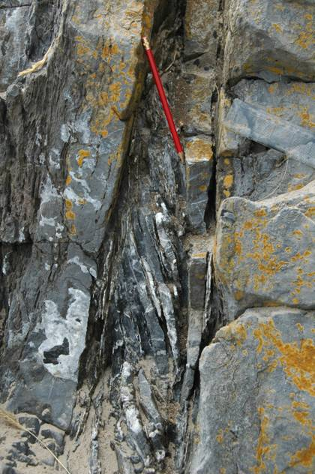
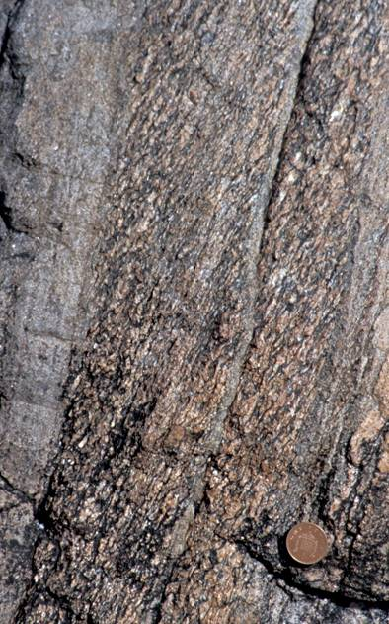

Cleavage (definitions)
The most significant planar fabric in folded rocks is cleavage or schistosity
Cleavage = the fabric formed in fine-grained rocks up to a scale at which individual cleavage-forming minerals are visible to the naked eye (applies at low metamorphic grade)
Schistosity = coarser-grained foliations formed at higher metamorphic grades
Both may be described as penetrative or as spaced
Notes:
The term ‘fracture cleavage’ is commonly used for a set of closely spaced fractures in brittle lithologies; the description ‘phyllitic’ may be used for fabrics that are transitional between cleavage and schistosity; the term ‘gneissosity’ may be used for a deformation-induced fabric in very high-grade rocks, although this is now largely out of favour because of the possible confusion it may cause with compositional layering in gneisses
There are many terms that have been developed to describe the morphology of cleavage and schistosity (e.g., see Passchier & Trouw, 2005, Microtectonics (2nd edition), Fig. 4.7, or Price & Cosgrove, p.434-5) but while these allow a certain descriptive precision, they are not particularly useful
Photo left (Steve Covey-Crump): cleavage in Precambrian units, Charnwood Forest, Leicestershire. Note how the cleavage changes dip in passing from the dark grey units to the buff-brown units. This is the phenomenon of cleavage refraction (see Slide 33)
Photo middle (Steve Covey-Crump): fracture cleavage in Carboniferous limestones, West Angle Bay, Pembrokeshire
Photo right (Steve Covey-Crump): schistosity in deformed Moine metasedimentary units, south coast of the Ross of Mull, Scotland

Slide 29



Cleavage (axial planar)
Cleavage/schistosity generally forms parallel or sub-parallel to the axial surfaces of folds. When it does, it is described as axial planar cleavage
Axial planar cleavage is invaluable for determining the orientation of the axial surface and also, by using the cleavage/bedding intersection, the fold axis orientation
Notes:
Figure top left: from Price & Cosgrove, p.436
Photo left (from the image database accompanying Passchier & Trouw, 2005, Microtectonics (2nd edition)): axial planar cleavage in a thin section scale fold (height of image 20 mm); phyllite from the Swedish Caledonides
Photo right (Steve Covey-Crump): fold at Bwa Du, on the NW limb of the Rhoscolyn antiform, Anglesey

Slide 30


Cleavage (axial planar) 2
When you are mapping:
don’t forget to measure CLEAVAGE
and, if possible, the
CLEAVAGE / BEDDING INTERSECTION
Notes:
When marking field maps, one of the biggest discriminators is between those who have bothered to measure cleavage and those who have not. It is not always easy to put your compass on a cleavage plane, but it is usually straightforward to align a notebook with the cleavage and measure that instead
Figure top left: from Price & Cosgrove, p.436
Photo left (Steve Covey-Crump): trace of axial planar cleavage in folded pelites, Penally Point, north side of Boscastle Harbour, Cornwall
Photo right (Steve Covey-Crump): axial planar cleavage (with the appearance of a spaced fracture cleavage) in the rounded hinge fold shown on Slide 19; folds within the South Alligator Group, Kakadu Highway, south of Darwin, Australia

Slide 31



Cleavage (asymmetry)
The sense of cleavage/bedding asymmetry of an axial planar cleavage may be used to determine location on the larger scale fold structure. The sense of asymmetry may be determined using the S/Z nomenclature or by using the direction of vergence (in this case, defined as the horizontal direction within the profile plane that the top of the cleavage trace must be rotated so that the cleavage becomes parallel with bedding)
Z
S
Notes:
To establish S or Z asymmetry, you trace along bedding – along cleavage – along bedding, making acute angles. You must be looking down the fold axis
The direction of vergence (indicated by the orange arrows above) is obtained by establishing which way you have to rotate the top of the cleavage trace to make it parallel with the trace of bedding. The direction of vergence points towards the antiform; it doesn’t matter which way you are looking
Figure left by Steve Covey-Crump (the bottom part of this figure was based on Lisle, 2004, Geological Structures and Maps: A Practical Guide (3rd edition), p.99)
Photo middle (Steve Covey-Crump): Marloes, Pembrokeshire
Photo right (Steve Covey-Crump): road section in Clue du Pérouré, near Digne-les-Bains, France

Slide 32



Cleavage (fanning/transecting)
Except in the hinge, cleavage is often not exactly parallel with the axial plane but rather it fans about the fold in a convergent or divergent manner
Alternatively, when folding occurs in a transpressive regime, the cleavage may be systematically oblique to the axial plane (transecting cleavage)
convergent
divergent
Notes:
Transpression is a combination of shearing with compression (we will consider transpression properly in Classes 4 and 10). Transecting cleavage is a feature of the North Wales slate belts
Figure top left is from Price & Cosgrove, p.436
Two figures bottom left are from Fossen, p.263
Figure right is from Fossen, p.295

Slide 33



Cleavage (refraction)
Cleavage is often observed to change dip (but not strike) as it passes from one lithology to another. This phenomenon (cleavage refraction) reflects differences in the resistance to flow (the competence) of the layers. Cleavage in more competent lithologies (typically, ones that are less clay-rich) tends to be at a higher angle to bedding than it is in less competent layers
Notes:
More competent lithologies are ones that are more resistant to flow
With caution, refracted cleavage may be used as an indicator of graded bedding – it usually becomes more nearly parallel to bedding as the clay mineral content increases towards the top of a normally graded bed. Using this logic in the photo on the left the units are younging towards the left (look at how the cleavage curves across the lighter coloured, more quartz-rich units). The cleavage/bedding asymmetry (S in this view) suggests antiform to the left, but the beds are also younging in this direction. Hence to the left is a synclinal antiform. In this case the cleavage is actually a cleavage generated in a later folding event than the one that formed the antiform and so we can’t really say this – care is required in making too many inferences from a photo at this scale (one needs to match the generation of cleavage to the generation of fold). In the photo on the right the cleavage refraction suggests younging to the right (the cleavage/bedding asymmetry suggests synform to the right – synclinal synform)
Photo left (Steve Covey-Crump): north shore of Loch Leven at Kinlochleven (we’ll see this locality on the Easter field course to Scotland). Inset figure from Price & Cosgrove, p.436
Photo right (Steve Covey-Crump): Precambrian units at Charnwood Forest, Leicestershire

Slide 34


Cleavage (crenulation)
The fine-scale layering of cleavage and schistosity means that if the rock is deformed for a second time, the cleavage or schistosity is refolded on a sub-millimetre to centimetre scale. The hinges of these small folds are described as a crenulation lineation and their axial planes as a crenulation cleavage
Notes:
If a rock with a well-developed deformation fabric is re-deformed, then a new fabric is formed. We describe this as a crenulation cleavage. Hence, by definition, the existence of a crenulation cleavage means that the rocks have been deformed more than once
In the photo on the left, ignore the thin Tertiary dyke and look at the light grey surface. This is a bedding surface and the lineation on it which has a pitch of about 30° to the left is a crenulation lineation (in this case, an S₂/S₀ intersection lineation). In the photo on the right, the cleavage running left-right is folding an earlier cleavage running approximately up-down. The folds are sufficiently well defined to measure an axial plane (= crenulation cleavage)
Photo left (Steve Covey-Crump): folded Moine metasedimentary units on the south coast of the Ross of Mull, Scotland
Photo right (BGS image database: geoscenic.bgs.ac.uk/asset-bank/action/viewHome, image P204238): folded Dartmouth slates at Blackpool beach, Stoke Fleming, Devon

Slide 35


Crenulation cleavage development
S₀ original surface (bedding)
S₁ first cleavage
S₂ second cleavage (crenulation)
low T
Gentle crenulation of S₁ but no S₂
Tighter crenulation and a discrete S₂ visible
S₁ and S₂ of equal importance; recrystallized microfold hinges at higher temperatures
S₂ predominates with S₁ visible in relict fold hinges; new grains grown along S₂ dominate the fabric
S₁ completely transposed
high T
Notes:
35
Note the notation: S₀ is the original surface (bedding), S₁ is the first cleavage, S₂ is the second cleavage, and so on. We can also use D₁, D₂, . . . to refer to deformation phase 1, 2, etc., F₁, F₂, . . . to refer to folds formed in the 1st phase of deformation, 2nd phase of deformation, etc., and L₁, L₂, . . . to refer to lineations formed in the 1st phase of deformation, 2nd phase of deformation, etc.
The formation of crenulation cleavage is discussed by Cosgrove, 1976, Journal of the Geological Society, London 132: 155-178, https://doi.org/10.1144/gsjgs.132.2.0155; and by Knipe, 1981, Tectonophysics 78: 249-272, https://doi.org/10.1016/0040-1951(81)90016-0
Figure from Passchier & Trouw, 2005, Microtectonics (2nd edition), Fig.4.18
Photo (Steve Covey-Crump): a spaced crenulation cleavage, Kinlochleven (at this locality this is actually S₃ crenulating S₂; S₁ is not visible in the photo). The thin quartzitic layers are bedding but there is a fine S₂ cleavage almost bedding parallel which is rather challenging to see in this photo. The development of the crenulation cleavage is at about stage 3 in the figure above

Slide 36


Crenulation cleavage/bedding asymmetry
The cleavage/bedding asymmetry relationships apply for folds of given deformation phase
S₂/S₀ changes asymmetry across an F₂ fold but S₁/S₀ does not
S₁/S₀ is everywhere S asymmetry (verging to NW)
Notes:
36
Photo top (Steve Covey-Crump): an F₂ fold within the South Stack Formation, Rhoscolyn, Anglesey. Note that there is an early cleavage (S₁) that is oblique to bedding (S₀) on the short steep limb (S₁/S₀ has S-asymmetry) and that this is folded around the hinge of the antiform. It is not easy to see but on the long, gently dipping limbs you can just make out that S₁/S₀ has S-asymmetry. Note also the presence of a spaced crenulation cleavage (S₂) axial planar to the folding, in the core of the antiform
Figure (Steve Covey-Crump) illustrating how S₁/S₀ asymmetry remains the same (here an S) all the way around an F₂ antiform-synform pair

Slide 37
Crenulation cleavage/bedding asymmetry
The cleavage/bedding asymmetry relationships apply for folds of given deformation phase
S₂/S₀ changes asymmetry across an F₂ fold but S₁/S₀ does not
S₁/S₀ is everywhere S asymmetry (verging to NW)
Notes:
37
Photo top (Steve Covey-Crump): an F₂ fold within the South Stack Formation, Rhoscolyn, Anglesey. Note that there is an early cleavage (S₁) that is oblique to bedding (S₀) on the short steep limb (S₁/S₀ has S-asymmetry) and that this is folded around the hinge of the antiform. It is not easy to see but on the long, gently dipping limbs you can just make out that S₁/S₀ has S-asymmetry. Note also the presence of a spaced crenulation cleavage (S₂) axial planar to the folding, in the core of the antiform
Figure (Steve Covey-Crump) illustrating how S₁/S₀ asymmetry remains the same (here an S) all the way around an F₂ antiform-synform pair

Slide 38

Cleavage (crenulation) 2
Identifying generations of cleavages, and (for each generation) measuring the cleavage plane and the cleavage/bedding intersection lineation is a key mapping skill
Honing these skills is a major objective of any mapping field course that is not just introductory
S₀
S₁
In the photo right:
bedding (S₀) is given by the change in lithology;
the first cleavage (S₁) is the penetrative fabric running top right to bottom left (D₁ antiform to the left)
the second cleavage (S₂) is the spaced, weakly developed fabric running top to bottom (note that it is axial planar to the folded cleavage in the quartzite layer)
S₂
Notes:
Photo (Gray et al., in: Birch (editor), 2003, Geology of Victoria, Geological Society of Australia Special Publication 23, p.26): Avoca Fault Zone, near Pitfield, Victoria, Australia

Slide 39

Mineral elongation lineations
Lineations formed during deformation and often lying within the cleavage plane, include:
Preferred orientation of minerals with an acicular or prismatic habit
Small, elongate concentrations of individual minerals
Minerals with elongate mineral overgrowths
Grains or other discrete objects that have been deformed into well-aligned elongate shapes
Aligned biotite porphyroblasts formed mimetically, parallel to a pre-existing lineation – the biotite porphyroblasts overgrow a crenulation (S₂) but are parallel to a strong lineation (L₁) seen elsewhere in the vicinity
Notes:
Photo (Steve Covey-Crump): phyllites from the Onich shore section

Slide 40


Stretching lineations
Mineral elongation lineations formed parallel with the maximum extension direction of the structure on which they occur, are described as stretching lineations
Stretching lineations are parallel with the tectonic a-direction (transport direction) – the orientation of this direction may be at any angle to the fold axis within the axial plane
Garnet porphyroblasts with elongate quartz overgrowths parallel with a well-developed stretching lineation
Notes:
We will define terms like ‘maximum extension direction’ properly in Class 3. For the moment think of the maximum extension direction as the direction in which the rocks have been stretched
Photo bottom left (Steve Covey-Crump): stretching lineation, Upper Shiaba Psammite, Moine units, Ross of Mull
Photo right (Steve Covey-Crump): from the Moine metasedimentary units on the south coast of the Ross of Mull, Scotland. It is conceivable that the missing halves of the quartz overgrowths have been eroded out if they grew slightly out of plane of the photographed bedding surface

Slide 41


Pinch-and-swell/boudinage
During folding it is not uncommon for the limbs to be attenuated
Gentle oscillations of the thickness of the bed are described as pinch-and-swell structures; if the layer is periodically separated it is described as boudinage
Boudinage
Pinch-and-swell
Notes:
The term boudinage derives from the French ‘boudin’ meaning ‘blood sausage’
Photo left (Steve Covey-Crump): a layer showing pinch-and-swell, Moine metasediments, Glenfinnan
Photo right (Fossen, one of the extra figures on the web-site for the book, folk.uib.no/nglhe/StructuralGeoBook.html, photo by J. Jacobs): boudinaged gneiss, Mozambique. These are barrel-shaped boudins (see next slide)

Slide 42



Pinch-and-swell/boudinage (shape and orientation)
The shape of the boudins (block, barrel, fish-mouth) depends upon the contrast in competence with the adjacent layers
The boudin neck-lines may be parallel with the fold axis
Boudin necks are frequently infilled with a secondary mineral deposit
Notes:
Figure top from Twiss & Moores, p.312
Figure bottom right by Steve Covey-Crump based on an original by Ernie Rutter. The ‘boudin neck-lines’ are labelled as ‘boudin long axes’ on the diagram
Photo left (Fossen, one of the extra figures on the web-site for the book, folk.uib.no/nglhe/StructuralGeoBook.html): block-shaped boudins in some gneisses. Note the bleaching of the boudin necks which indicates that the fractures served as fluid pathways

Slide 43






Pinch-and-swell/boudinage (symmetry)
Boudins may be symmetric, or if formed in the presence of a layer parallel shear, asymmetric
The rotation of the boudins may be with the sense of shear (photo far right) or against it (figure below)
symmetric
asymmetric
Notes:
The two diagrams are from Fossen (p.316, p.320)
Photo bottom left (from Fossen, p.318): a dyke that shows extreme symmetric pinch-and-swell, Finnmark, northern Norway
Photo middle (Steve Covey-Crump): symmetric pinch-and-swell structures in some bedding-parallel quartz veins, Combe Martin, Devon. Note that the wavelength of the pinch-and-swell decreases as the layer becomes thinner (we shall discuss this further in Class 2)
Photo right (Steve Covey-Crump): rotated boudins on the eastern limb of the Assapol synform, south coast of the Ross of Mull. The core of the synform is to the left, implying (assuming a flexural slip model of fold formation, see Class 2) that the sense of layer-parallel shear is dextral, that is, that the boudins have rotated in the direction of shear (indicated by the red lazy arrow)

Slide 44


Lineations parallel to the fold axis (mullions)
The interface between layers of very different competence may take the form of convex surfaces with intervening cusps. These are described as mullions
The long axis of mullions is typically parallel with the fold axis
The cusps point into the more competent unit
Notes:
Photo left (Steve Covey-Crump): cuspate contact at the base of a quartz-rich bed, Moine metasedimentary units, south coast of the Ross of Mull, Scotland
Photo right (from Hobbs et al., 1976, An Outline of Structural Geology, p.277): mullions, Dederborn, Ardennes, Belgium

Slide 45


Reading
Fossen H (2016) Structural Geology (2nd edition). Cambridge University Press. [Chapters 12, 13, 14, 15]
Twiss RJ, Moores EM (2007) Structural Geology (2nd edition). WH Freeman and Co. [Chapters 10, 11]
Price NJ, Cosgrove JW (1990) Analysis of Geological Structures. Cambridge University Press. [Chapters 10, 16, 17, 18]
Ragan DM (2009) Structural Geology: An Introduction to Geometrical Techniques (4th edition). Cambridge University Press. [Chapter 14]
Ramsay JG, Huber MI (1987) Techniques of Modern Structural Geology. Volume 2: Folds and Fractures. Academic Press. [Sessions 15, 17]
Extra resources for Fossen’s book at
http://folk.uib.no/nglhe/StructuralGeoBook2ndEd.html
The 1st edition is available on-line through the library; the library has ~ 10 hard copies of the 2nd edition
Notes:
The primary course text is Fossen’s book. This is a beautifully illustrated survey of the subject and is well supported by extra resources on the web, including some Emodules and animations that you may find helpful. The extra resources pages noted on this slide also provide links to other sites containing structural geology resources. There are hard copies of this text in the library, and online access through the library. I have also added Fossen’s book on Plate Tectonics as a course text; it is most relevant for the last three classes of this unit, and for anything you might do with tectonics in your 3rd year
Twiss & Moores is significantly more detailed than Fossen but without the colourful photos. It is a superb text with very clear explanations of concepts taken from first principles, and so it provides an opportunity to establish greater depth to your understanding than can be obtained from Fossen
I have added Price and Cosgrove to the texts because they taught me structural geology and so for me their approach is particularly clear. The chapters on how folds form (dealt with in the next class) and minor fractures (dealt with in Class 6) are particularly good additions to the explanations given by Fossen and Twiss & Moores
Ragan is very good for some of the practical techniques described in this course unit, particularly for strain analysis (Class 3) and stress analysis (Class 5)
Ramsay & Huber is a set of worked practical exercises. This is not a course text, but you may find it interesting to see how the practical techniques introduced in this course unit may be taken further. Volume 1 deals with strain analysis (Class 3); Volume 2 with the analysis of folds and faults

